Slide 1

MA2012 INTRODUCTION TO MECHATRONICS SYSTEMS DESIGN
Lecture 3
Prof Ang Wei Tech
College of Engineering
School of Mechanical and Aerospace Engineering

Slide 2
RECAP
Arduino Uno MCU Board
ATMega 328 MCU
Number of bits, processor speed
Memory: RAM, EEPROM, Flash Memory
Other components
Digital I/O pins, ADC pins, power supply
Programming Environment: Arduino IDE
Connecting PC to Arduino Board
Bootloader Program

Slide 3
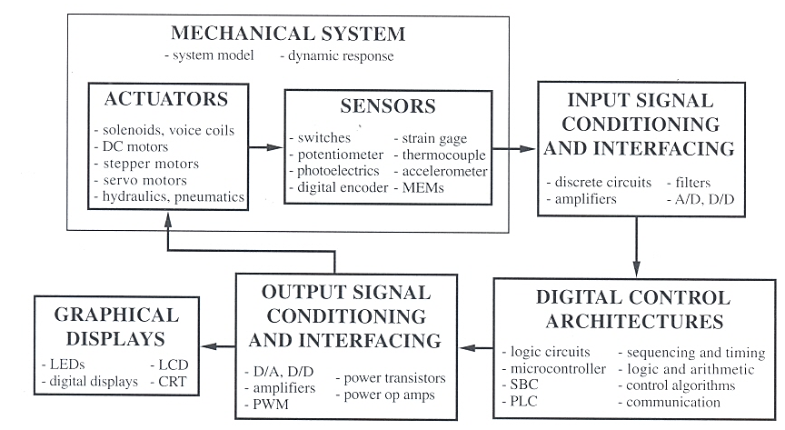
MECHATRONIC SYSTEM COMPONENTS

Slide 4
SENSOR
Transducer
A device which converts one form of energy into another
Sensor
A transducer which performs measurement
A device which produces an output signal (typically electrical) for the purpose of sensing a physical phenomena

Slide 5
SENSORS: ANALOG VS DIGITAL
Analog
Sensed quantity (voltage, current, etc.) is continuous
Usually (not always) needs an Analog to Digital Converter (ADC) to interface with MCU
Digital
Sensed quantity is discrete
Two-state devices: e.g. switches, Proximity Sensors
ON / OFF, High(1) / Low(0)
Multiple-state devices
Encoder: incremental and absolute

Slide 6
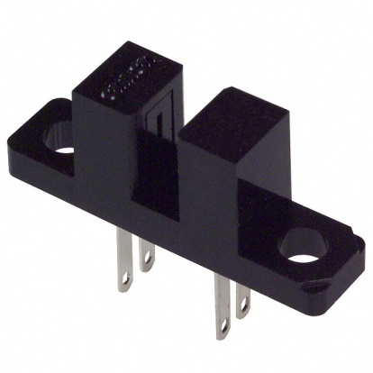
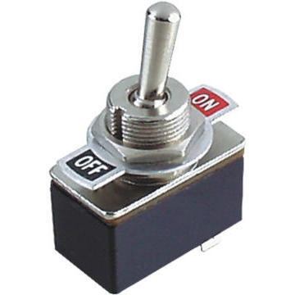
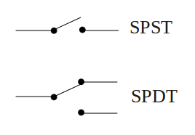
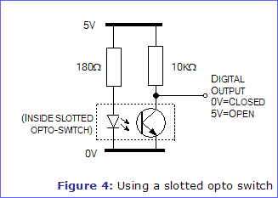
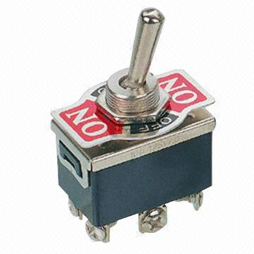
DIGITAL SENSORS
Switches
Slotted Opto Switch
Toggle Switch
Single
Double
Single Pole, Throw

Slide 7
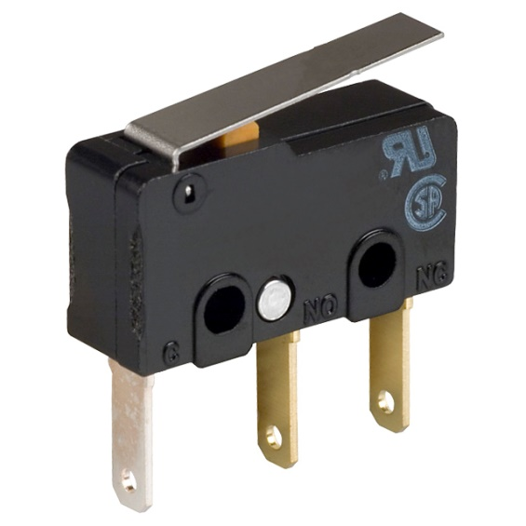
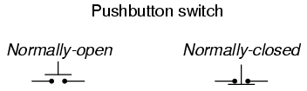
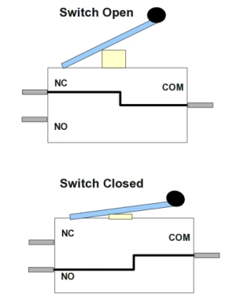
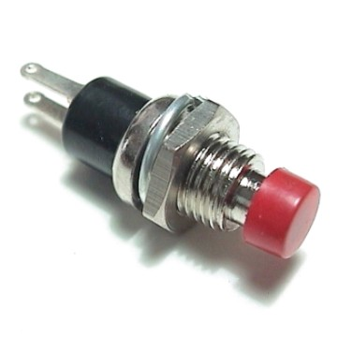
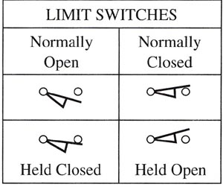
DIGITAL SENSORS
Switches
Limit Switch
NC
Common
NO

Slide 8
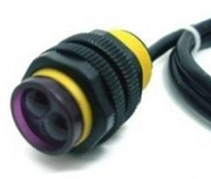
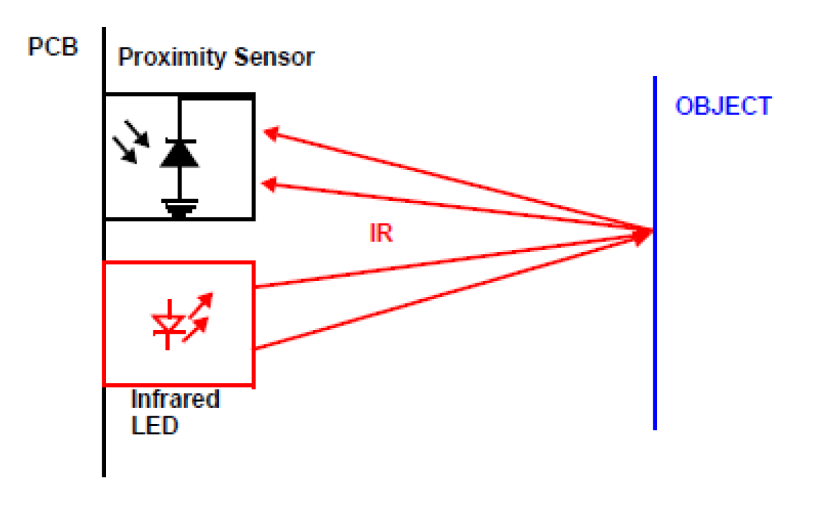
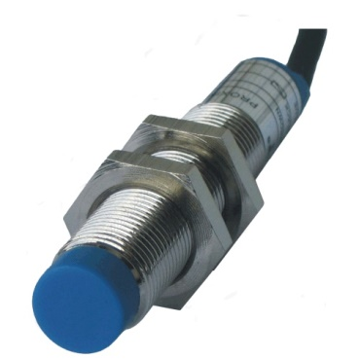
DIGITAL SENSORS
Proximity sensor
To detect presence of an object
Output: High or Low upon detection
Working principles
Infrared, Ultrasound: detection of incident waves reflected by object
E.g. Car reverse sensor
Inductive: change of induced current upon detection of ferrous materials
E.g. Metal detectors for security
Capacitive: change of capacitance upon detection of conductive materials
E.g. Touch screen
Infrared proximity sensor
Inductive / Capacitive proximity sensor

Slide 9
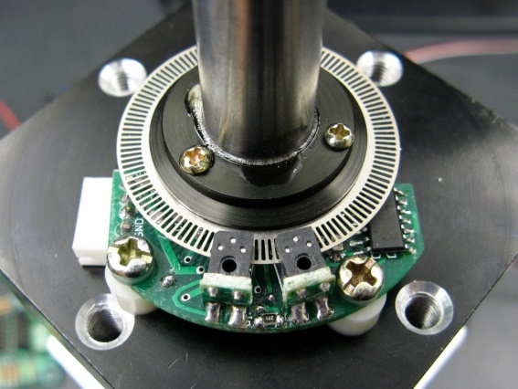
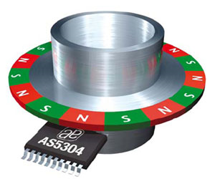
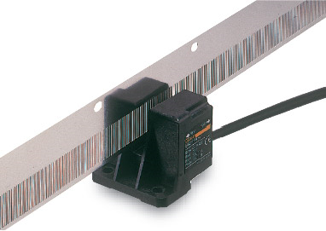
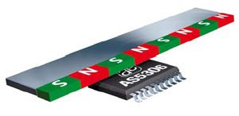
DIGITAL SENSORS
Digital Encoders
Hall-Effect
Optical
Rotary
Linear

Slide 10
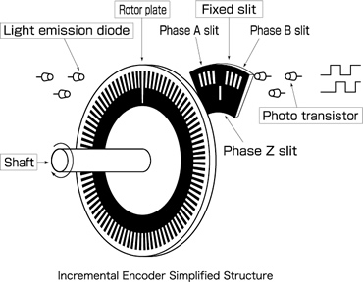
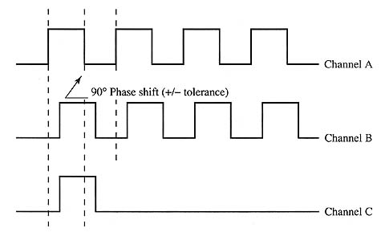
DIGITAL SENSORS
Incremental Encoder
Same working principle as
opto switch
ChA leads ChB by 90°: CCW
ChA lags ChB by 90°: CW
ChZ is a Home (Ref) pulse
Time (ΔT_{i}) between 2 pulses
determines the rotation speed:
ω_{i} = 2π / ΔT_{i}
Absolute Encoder
To be taught in other course
ΔT_{i}
Z

Slide 11
INTERFACING WITH DIGITAL SENSORS
Sensing modalities
To sense a State: HIGH or LOW
To measure the time duration of a State
Communication Protocols
Serial – one data after another
Synchronous vs Asynchronous
Cheaper but slower
Parallel – multiple data via multiple I/O pins
More expensive but faster

Slide 12
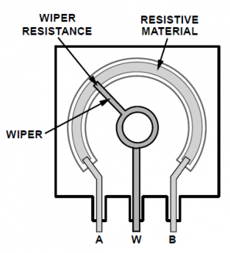
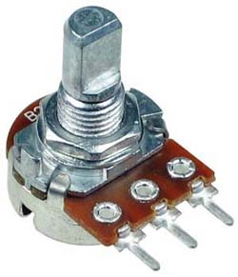
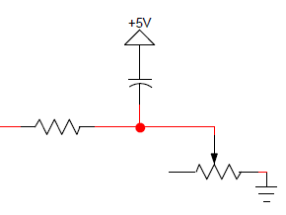
ANALOG SENSORS
POTENTIOMETER
To measure angular or linear displacement
Working principle: Voltage divider
Variable resistance ∝ Variable voltage
Applications
Light dimmer
Audio volume knob
A
W
To MCU via ADC
B

Slide 13
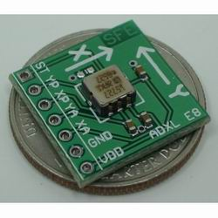
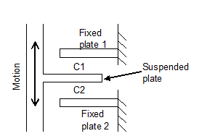
ANALOG SENSORS
ACCELEROMETER
To measure linear acceleration (movement & gravity)
Output: Voltage (Analog) or Duty Cycle (Digital)
Working principle:
Motion causes change of distance between plates and hence change of capacitance
Applications
Mobile device
Inclinometer

Slide 14
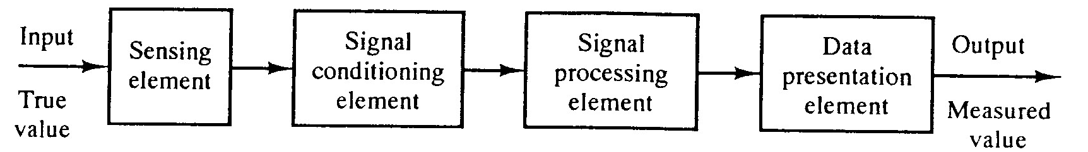
ANALOG SENSORS: DATA ACQUISITION
The process of sensing a physical state and convert it into digital form for processing, presentation and storage
Elements of Data Acquisition (DAQ) process:

Slide 15
ELEMENTS OF DATA ACQUISITION PROCESS
Sensing Element
This is in contact with the process and gives an output which depends in some ways on the variable(s) to be measured
E.g.
Thermocouple: mV e.m.f depends on temperature
Strain gauge: resistance depends on mechanical strain

Slide 16
ELEMENTS OF DATA ACQUISITION PROCESS
Signal Conditioning Element
This takes the output of the sensing element & converts it into a form more suitable for further processing, usually a d.c. voltage, d.c. current or frequency signal
E.g.
Amplifier which amplifies mV to V
Wheatstone bridge that converts impedance change into voltage change

Slide 17
ELEMENTS OF DATA ACQUISITION PROCESS
Signal Processing Element
This takes the output of the signal conditioning element and converts it into a form more suitable for presentation
E.g.
ADC which converts a voltage into a digital form
Computer which calculates the desirable measurement from raw data
Mass of gas from flow rate and density
Correction for non-linearity

Slide 18
ELEMENTS OF DATA ACQUISITION PROCESS
Data Presentation Element
This presents the measured value in a form which can be easily recognized by the observer
E.g.
Visual Display Unit (VDU)
Dial or pointer-scale indicator

Slide 19
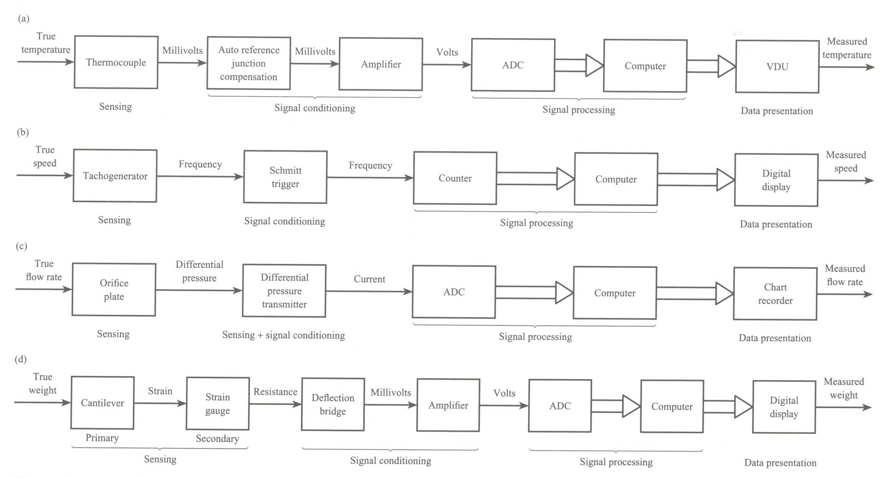
EXAMPLES OF DAQ PROCESS

Slide 20
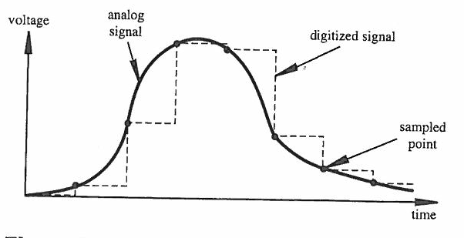
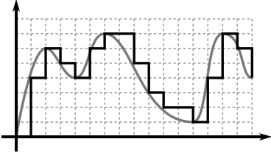
DIGITIZATION OF ANALOG SIGNAL
Digitized signal is a series of numbers which approximates an analog signal at the sampling time instances
Two important parameters
Sampling rate (x-axis)
Digitization resolution (y-axis)
Higher Sampling Rate & Resolution

Slide 21
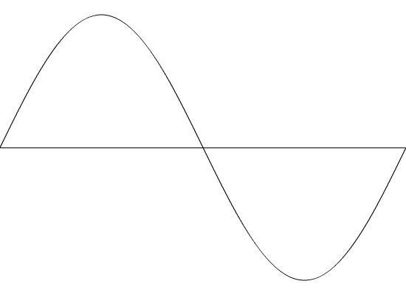
SHANNON SAMPLING THEOREM
No maximum sampling frequency
Higher frequency also means more noise, higher cost
Sampling frequency (f_{s}) must be at least 2 times higher than the highest frequency component (f_{max}) in the signal
f_{s} > 2f_{max} ; T_{s} < 0.5T_{min} [Period T = 1/f ]
Nyquist frequency = 2f_{max}
Consider the following 1 Hz signals:
f_{s} = 1.33 Hz
T_{s} = 0.75 s
f_{s} = 1.33 Hz
T_{s} = 0.75 s
f_{s} = 2.0 Hz
T_{s} = 0.5 s
f_{s} > 2.0 Hz
T_{s} < 0.5 s
2 samples
Ok!
Only 1 sample
NOT ok!
Both samples measure 0.
NOT ok!
At least 2 non-zero samples.
Ok!

Slide 22
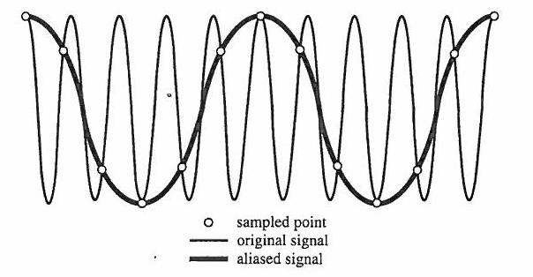
ALIASING
An effect that causes different signals to become indistinguishable (or aliases of one another) as a result of under-sampling
E.g. Original signal 10 cycles at f₀
f_{s} = 1.2 f₀
Total 12 sampling points
Sampled signal
appears to be 0.2 f₀

Slide 23

ALIASING - EXAMPLE
Wheels of forward moving car appear to rotate backward!
Click video to play

Slide 24
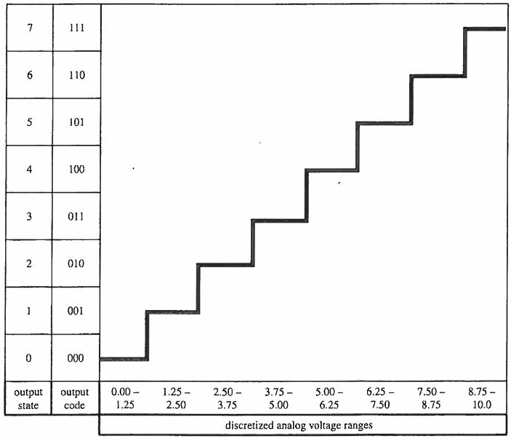
ANALOG-TO-DIGITAL CONVERSION
Quantizing Theory
Quantizing – conversion of continuous analog signal to a series of discrete states
Coding – assignment of a digital code number to each state
Number of states, N = 2^{n}
states: 0 … N–1
n–number of bits of A/D conversion

Slide 25
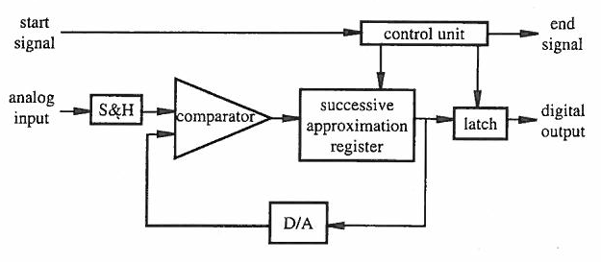
ANALOG-TO-DIGITAL CONVERTER
Successive Approximation
Fast, cheap, most widely used
A/D Conversion Steps
With a start signal, analog input is temporarily stored at the sample & hold (S&H) latch
The control unit makes an approximation of an digital equivalent of the analog input and hold the result at an output latch
The D/A converts the digital approximation to an analog signal and compares it with the analog input
If both equal, result held at the latch is output.
If not equal, go back to Step 2 to make the next successive approximation iteration.

Slide 26
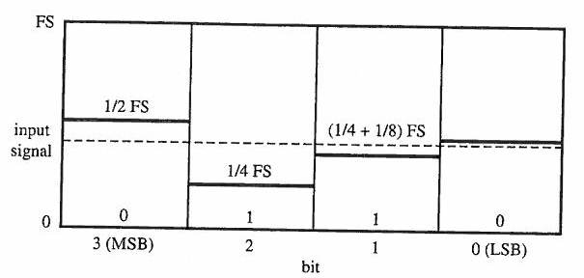
ANALOG-TO-DIGITAL CONVERTER
Successive Approximation E.g.
Full Scale (FS) = 1.0 V
Resolution (n) = 4 bits
Analog Input = 0.4 V
Control unit turns on only the most significant bit (MSB) Bit 3 which represents ½ FS = 0.5V. 1st approximation = 1000
It is larger than Analog Input (0.4V), hence Bit 3 is turned off.
Control unit turns on Bit 2 (1/4 FS = 0.25V). 2nd approximation = 0100
Current value (0.25V) < 0.4V, hence Bit 2 is remained on.
Control unit turns on Bit 1 (1/8 FS = 0.125V). 3rd approximation = 0110
Current value (0.25 + 0.125 = 0.375V) < 0.4V. Bit 1 is remained on.
Control unit turns on Bit 0 (1/16 FS = 0.0625V). 4th approx = 0111
Current value (0.375 + 0.0625 = 0.4375V) > 0.4V. Bit 0 is turned off.
Final output = 0110 = 0.375V

Slide 27
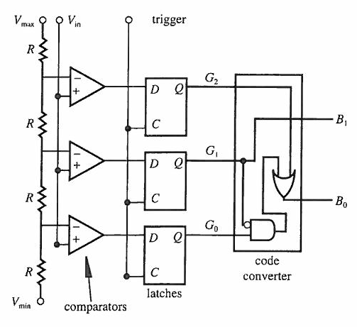
ANALOG-TO-DIGITAL CONVERTER
Flash Converter
Fastest type
Increasing resolution does not increase conversion time
A series of comparators acting in parallel to approximate an analog input
Flip-flop latches produce 3-bit code
AND & OR gates to convert 3-bit code to Binary output

Slide 28
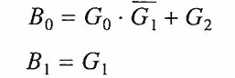
ANALOG-TO-DIGITAL CONVERTER
Flash Converter
State | Code (G₂G₁G₀) | Binary (B₁B₀) | Voltage Range (V)
0 | 000 | 00 | 0 – 1
1 | 001 | 01 | 1 – 2
2 | 011 | 10 | 2 – 3
3 | 111 | 11 | 3 – 4

Slide 29

SUMMARY
Digital Sensors
Switches, Incremental Encoder
Interfacing with Digital Sensors
ANALOG SENSORS
Analog Output (e.g. Potentiometer), Digital and Analog Outputs (e.g. accelerometer)
Acquisition process and elements
Digitization of analog signal
Shannon sampling theorem, Nyquisit frequency, Aliasing
A/D Conversion, ADC
Successive Approximation
Flash Converter

